Slide 1

If statement in Python

Slide 2
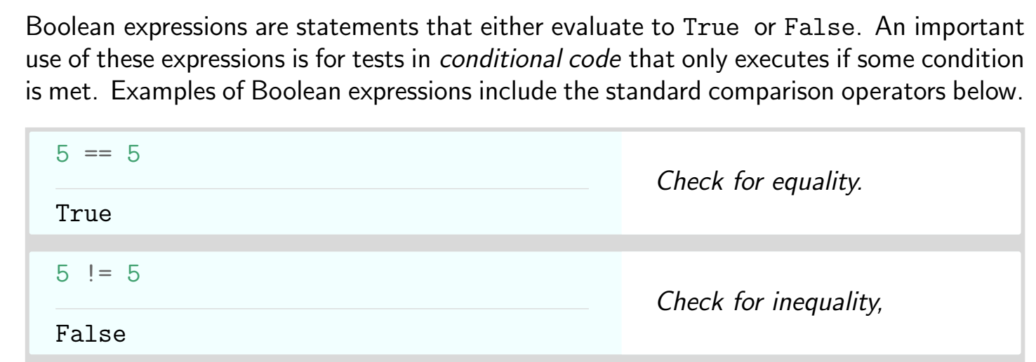
Boolean Expressions

Slide 3
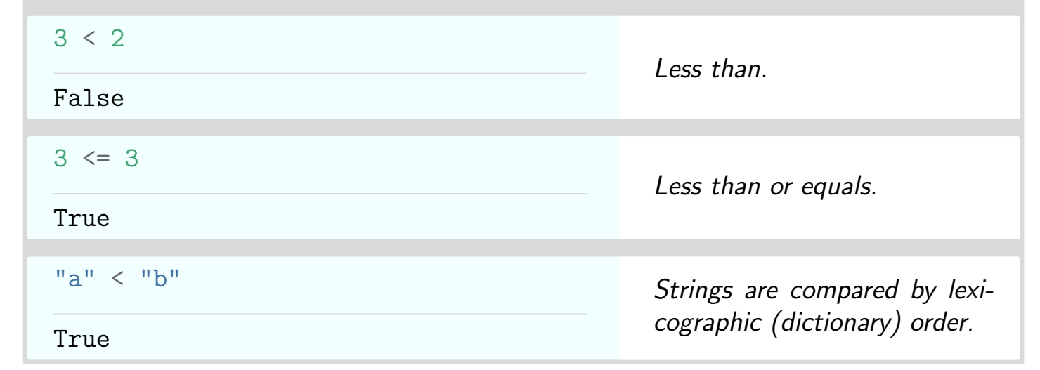
Boolean Expressions

Slide 4
Boolean Expressions

Slide 5
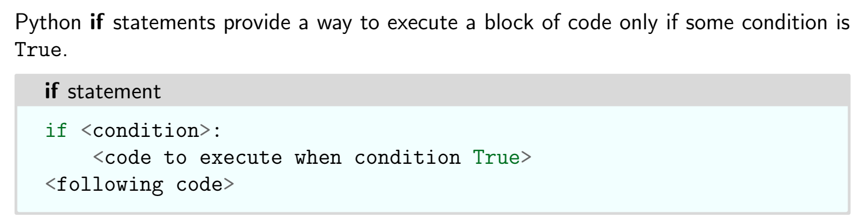
If statement

Slide 6
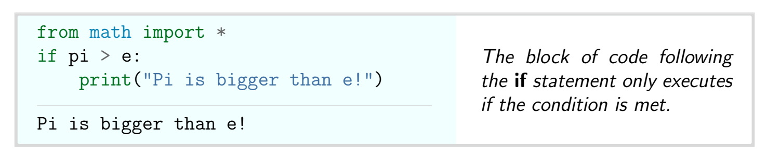
Example

Slide 7
Thank You

